Slide 1
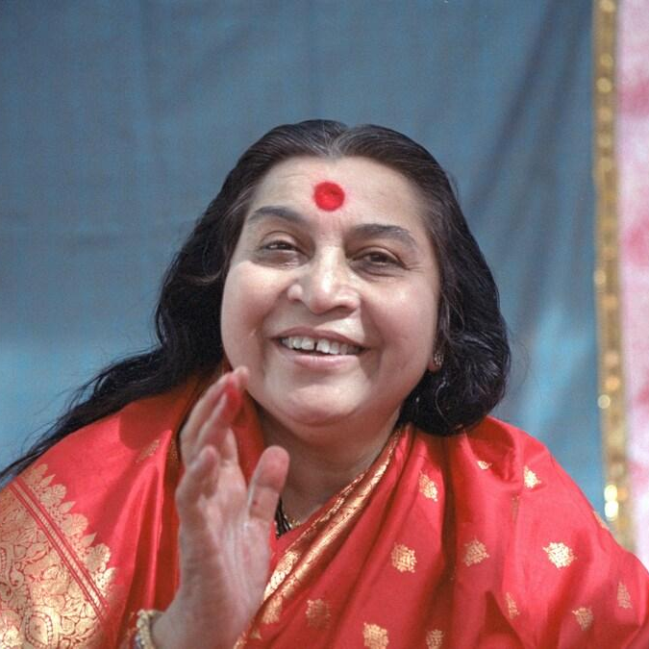
Introduction to Sahaja Yoga
Nirmala Vishwa Vidya Peetham https://nirmalavishwavidyapeetham.org/
Shri Mataji Nirmala Devi - The founder of Sahaja Yoga meditation

Slide 2
What is Sahaja Yoga?
In the words Sahaja Yoga, ‘Saha’ means ‘with’, ‘Ja’ means ‘born’, and ‘Yoga’ means union or connection with the universal energy or God or Mother Nature.
Sahaja yoga helps us easily awaken our inner energy called Kundalini to achieve this union and physically feel it as a cool breeze through a process called self-realization.
By practicing “Sahaja Yoga” meditation, we can always be joyful, peaceful, and achieve the highest state of human life.
It is very simple and anybody can feel this experience.
Sahaja yoga is always free and is practiced in several countries around the world.
Shri Mataji Nirmala Devi is the founder of “Sahaja Yoga” meditation and has given this gift to humanity.
Shri Mataji Nirmala Devi - The founder of Sahaja Yoga meditation

Slide 3
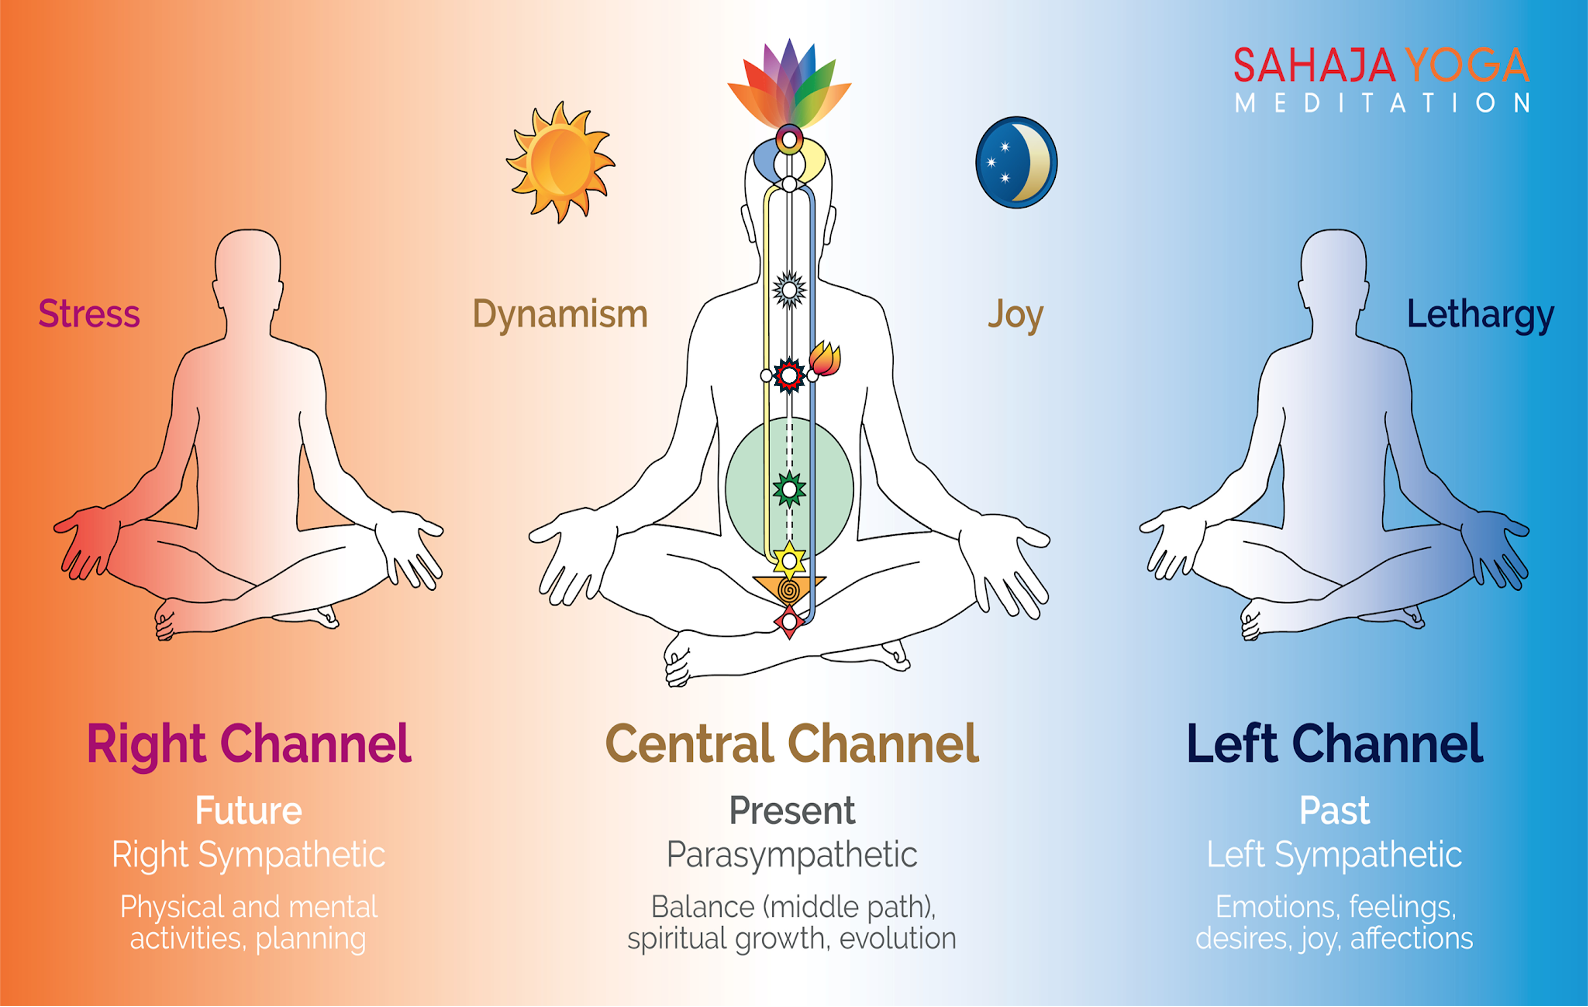
Chakras and Channels
Chakras:
Chakras are like energy centers located near different parts of our spinal cord, and control our physical and mental states.
There are seven chakras in our body:
Moladhara, Swadhistana, Nabhi (Void), Anahata, Vishuddhi, Agnya, and Sahastrara.
Each chakra helps maintain different emotional and mental qualities. It also takes care of physical organs around it.
When our chakras are in balance, we will be healthy physically and mentally.
Sahaja Yoga guides us on how to take care of our seven chakras.

Slide 4
Chakras and Channels
Channels:
There are 3 Channels within us which control our past, present and future activities.
Left channel or Moon channel (Past) – takes care of our desires, emotions and feelings (shown in blue)
Right channel or Sun channel (Future) – takes care of our planning, physical and mental activities (shown in yellow)
Central Channel (Present) – takes care of our spiritual growth and maintaining balance (shown in white)

Slide 5
Self-Realization
Kundalini energy:
Kundalini energy is a motherly energy inside us.
It is at the bottom of the spinal cord in a triangular bone called sacrum bone.
It stays in a dormant state.
Self-Realization:
When our Kundalini energy rises and passes through all the chakras, it reaches the chakra on top of our head and gets connected to the divine energy around us. This is called Self-Realization.
We can feel this in our hands, and on top of our head as a cool breeze.

Slide 6
Benefits
When we practice Sahaja Yoga meditation everyday morning and evening (around 5 to 10 minutes), and meditate in a group (called as collective meditation) at least once a week, it helps us in many ways:
The main benefit is that we will be always connected to God, or the Universal energy.
It cures physical, mental, and emotional problems.
It makes us peaceful and always keeps us in balance.
It balances our chakras which improve the qualities associated with those chakras within us. For example, when the swadhisthana (2nd chakra) gets balanced, our creativity improves (and reflects in various forms such as singing, dancing, painting, etc.).
It gives us good health and happiness, and makes us free from stress and tensions.
It teaches us to help each other and enjoy as a group.

Slide 7
Primordial Masters
Primordial masters (or Adi Gurus) are born at different times and taught us the principles to lead a dharmic life.
They also described about the experience and importance of self-realization
Below are the 10 primordial masters, as described by Shri Mataji:
1. Raja Janaka (~5000 BC, Nepal) | 2. Abraham (~1800-1600 BC, Mesopotamia)
3. Moses (~1300 BC, Egypt) | 4. Zarathusthra or Zoroaster (~630 BC, Persia)
5. Lao Zi or Lao Tzu (600-500 BC, China) | 6. Confucius (~551 BC, China)
7. Socrates (~470 BC, Greece) | 8. Prophet Muhammad (~570 AD, Mecca)
9. Guru Nanak (1469 AD, Punjab in Pakistan) | 10. Sainath (~1854 AD, India)

Slide 8

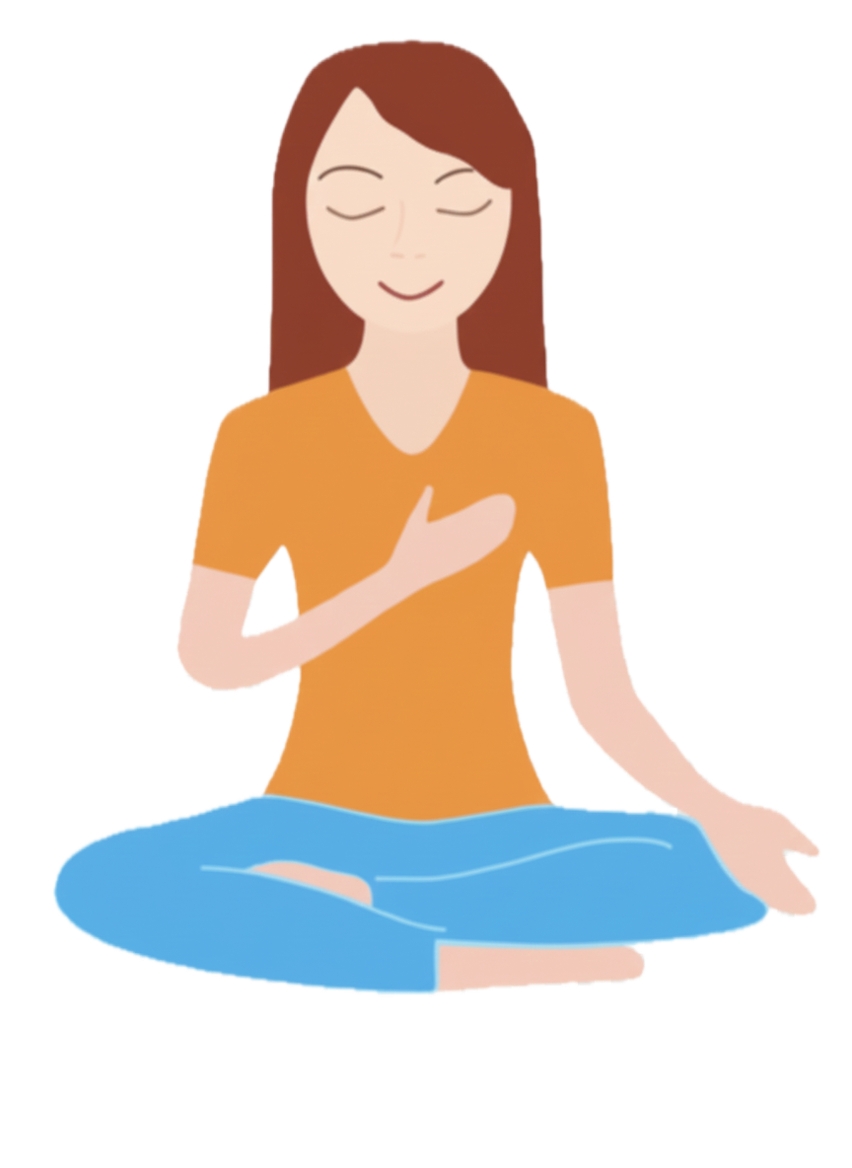
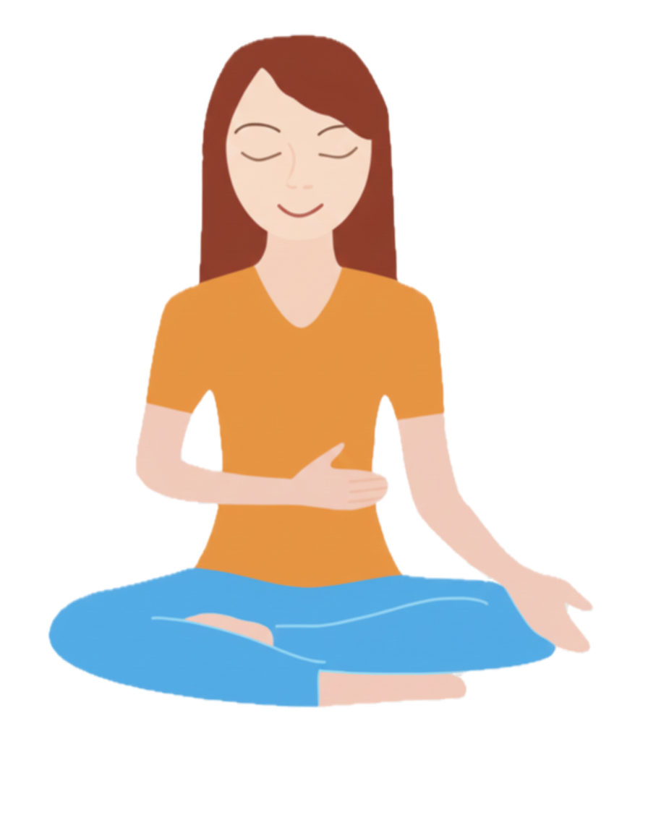

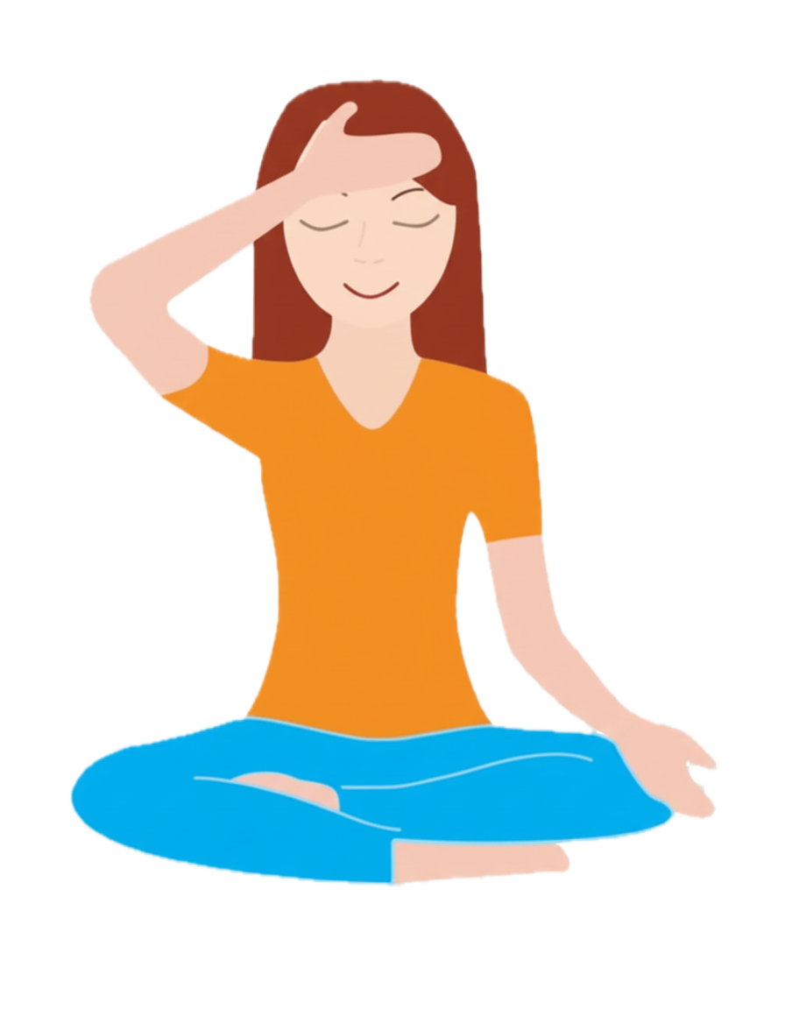
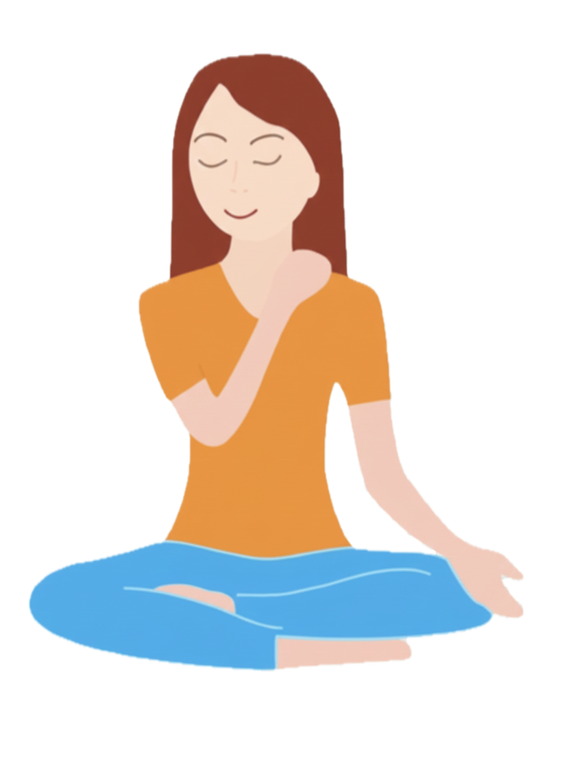
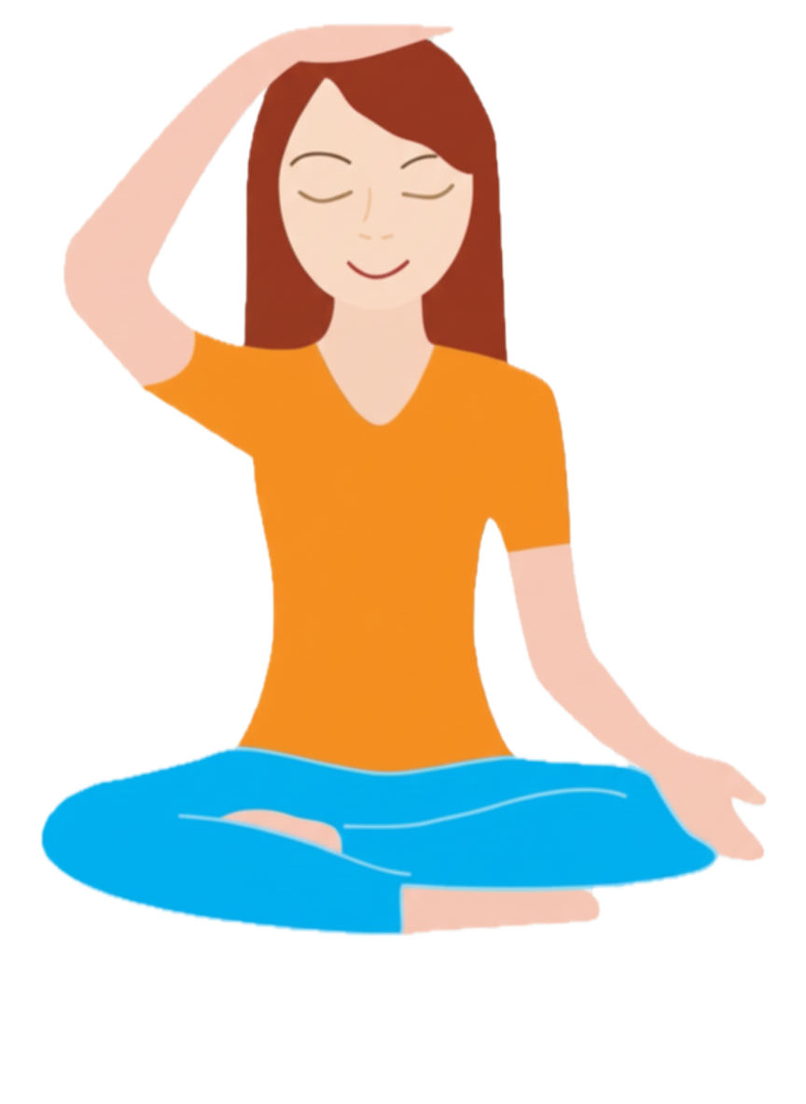
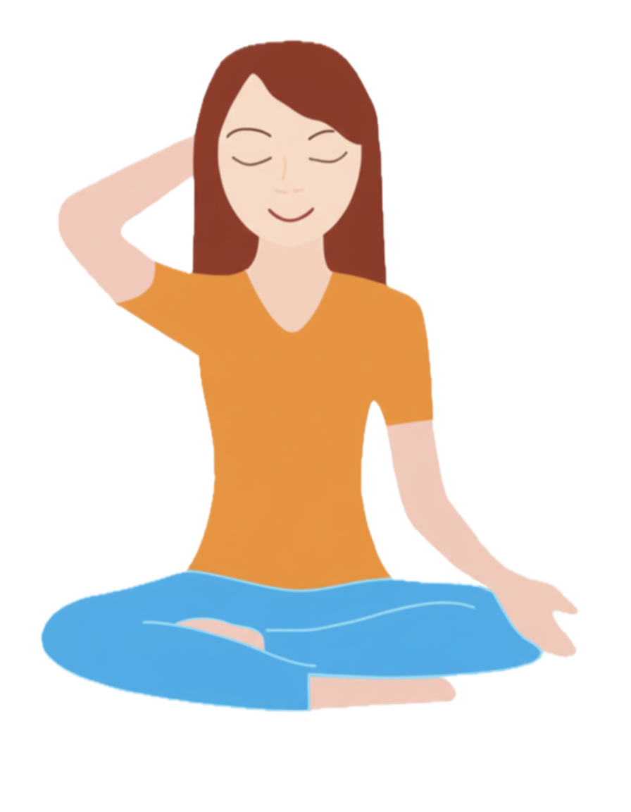
Self-realization – Steps

Slide 9

Experience Self-Realization by Shri Mataji

Slide 10
Bandhan
Bandhan or Kavacha means raising our Kundalini energy and creating a protection around us.
We should raise our kundalini and take Bandhan every time before and after meditation.
We do this exercise using our hands as guided in this video.

Slide 11

Bandhan
Bandhan or Kavacha means raising our Kundalini energy and creating a protection around us.
We should raise our kundalini and take Bandhan every time before and after meditation.
We do this exercise using our hands as guided in this video.

Slide 12
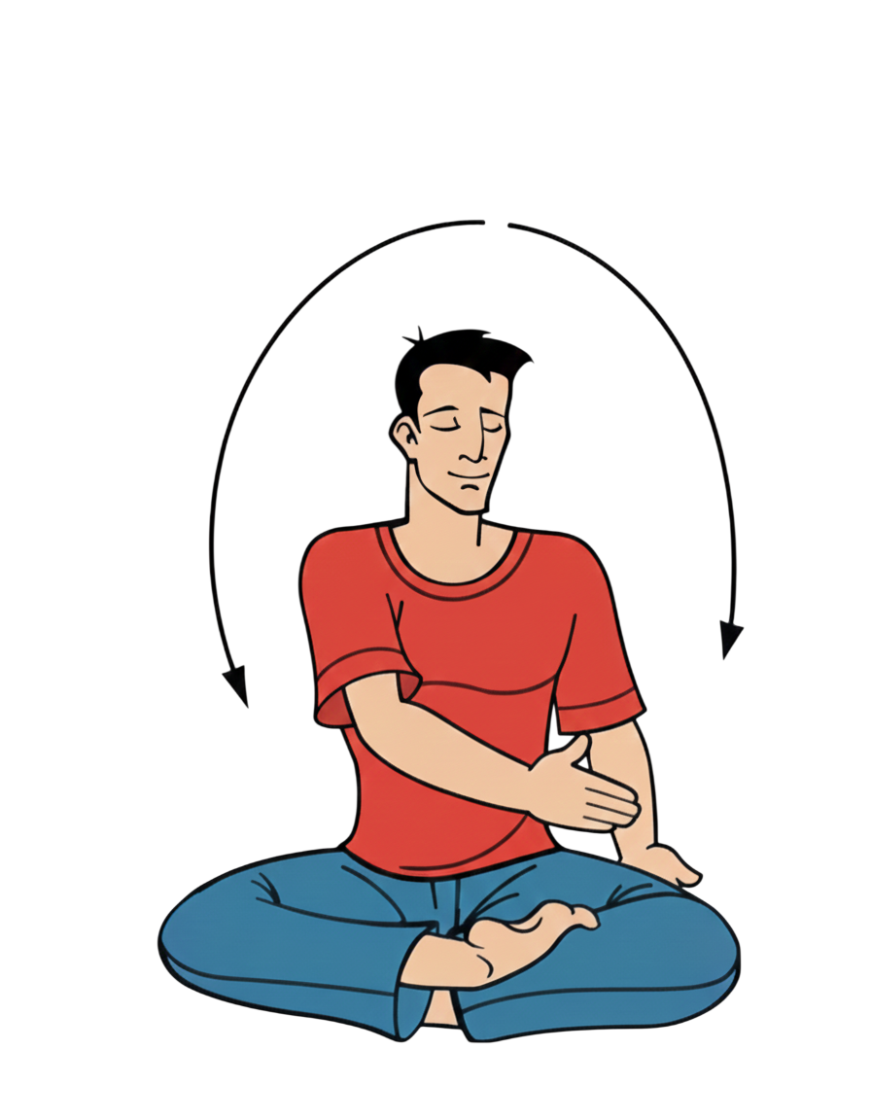
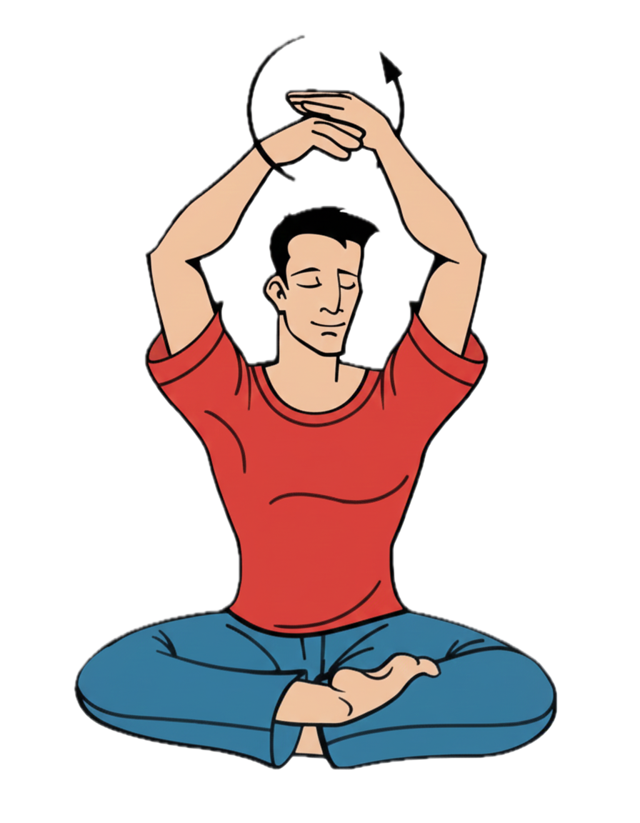
Bandhan – Uppy Uppy song

Slide 13
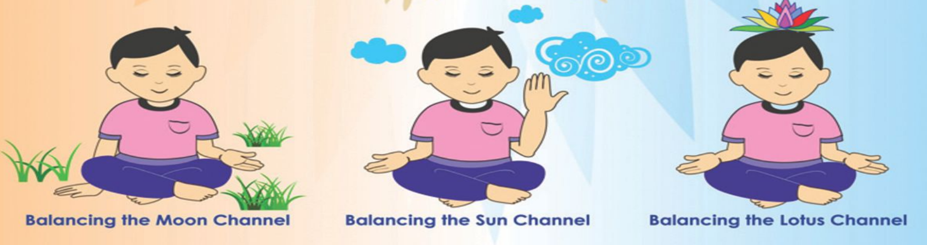

Daily meditation
We can follow these simple steps to remove imbalances and then sit in silent meditation for a few (~10) minutes to feel the cool breeze and peacefulness. We can take Bandhan before and after meditation.
Mother Kundalini, please balance my left channel
Mother Kundalini, please balance my right channel
Mother Kundalini, please keep me in the present. Please give me self-realization.

Slide 14
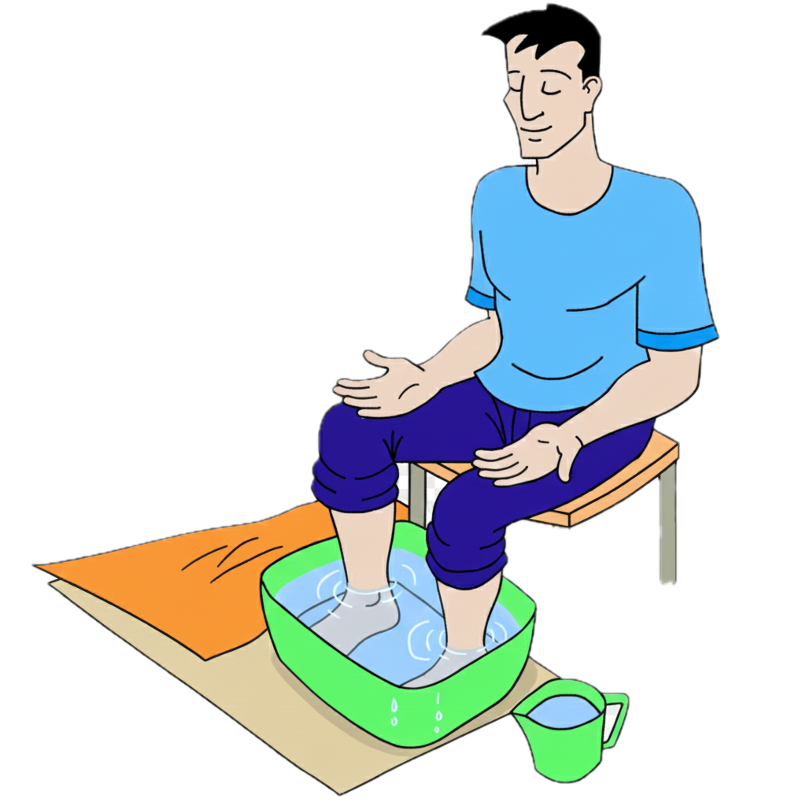
Foot - soaking
Foot-soaking is a method to cleanse our inner being using water element.
For best results, foot-soaking can be done in the night just before going to sleep.
Steps:
We light a candle in the room before doing this. Fill a tub with clean water and add a handful of salt. Keep a towel and a mug of fresh water ready.
Sit on a chair and give yourself ‘Bandhan’. Soak your feet in the water for 10-15 minutes to cleanse your channels.
When you are done, wash your feet with freshwater and wipe them dry. End the process by giving yourself Bandhan. Drain the used water down the toilet (as it contains impurities).

Slide 15
Collective meditation & References
Collective meditation is very important because we can feel calmness, easily improve our meditation, and learn techniques to keep us in balance.
To attend Sahaja Yoga collective meditation near your location, you can lookup ‘Sahajayoga <city/country> name’ in Google/Meetup.
This short introductory booklet gives you more details about Sahaja Yoga and how you can meditate everyday - Meditation-at-Home-Booklet
More information about Sahaja Yoga and center locations around the world can be found here:
sahajayoga.org
freemeditation.com
sahajayoga.org.in

Slide 16
Thank you!

